Slide 1



PAC: Assisted Value Factorization with Counterfactual Predictions in Multi-Agent Reinforcement Learning
Hanhan Zhou$^{1}$, Tian Lan$^{1}$, Vaneet Aggarwal$^{2}$
$^{1}$ The George Washington University
$^{2}$ Purdue University
Notes:
Intro

Slide 2
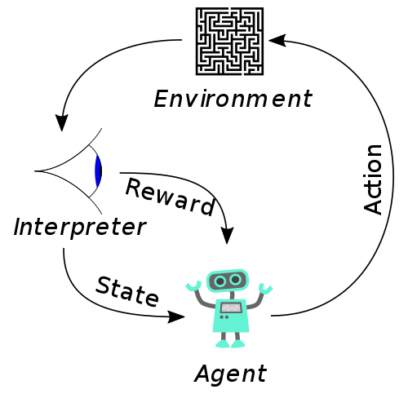
Basics: Reinforcement Learning
Reinforcement learning (RL) is an area of machine learning concerned with how intelligent agents ought to take actions in an environment in order to maximize the notion of cumulative reward. Reinforcement learning is one of three basic machine learning paradigms, alongside supervised learning and unsupervised learning.
*(Wikipedia)

Slide 3
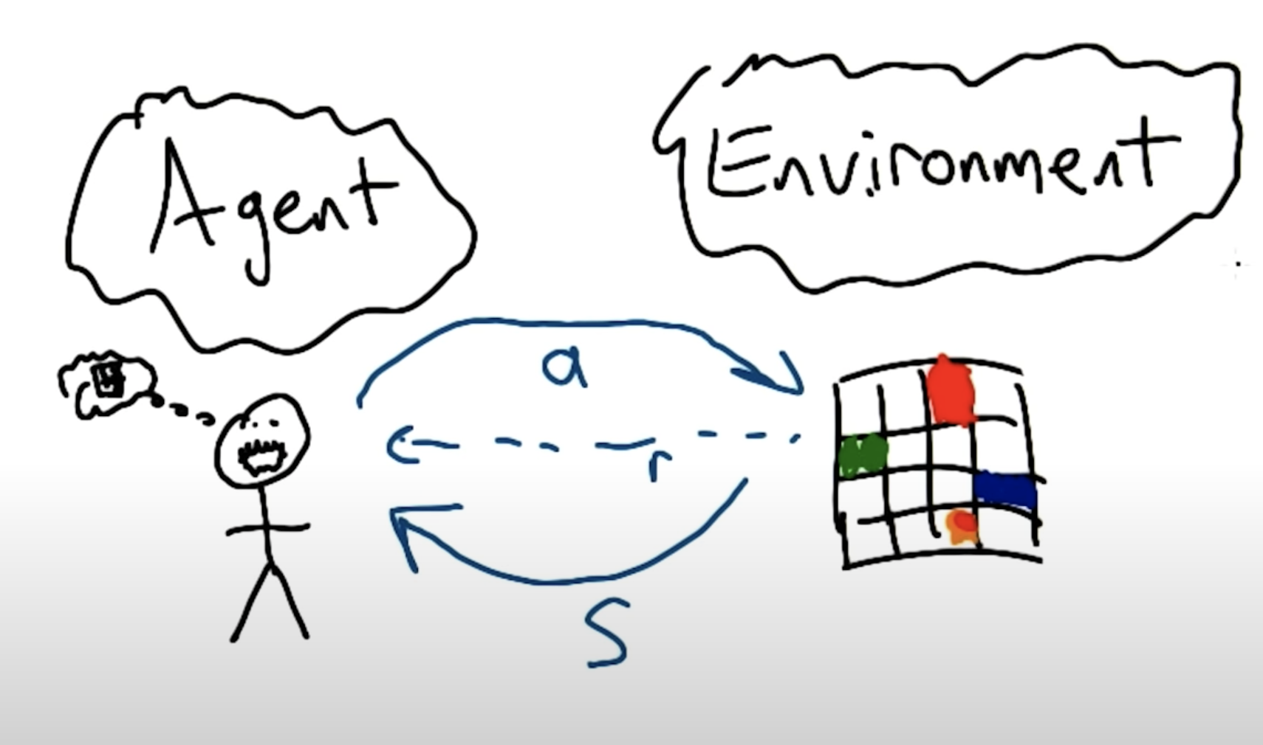
Basics: Reinforcement Learning
Conversation between the environment and the agent
S: state
O: observation
A: action
R: reward
Agent: a policy
Environment: MDP (maybe)
Notes:
RL is a conversation between the environment and the agent. Where the environment tells the agent XXXX,

Slide 4
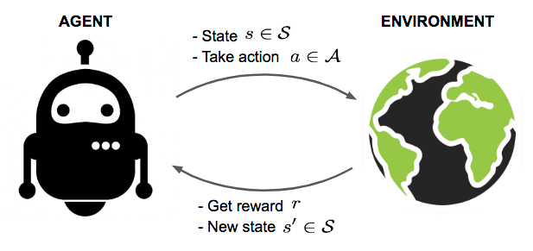
Basics: Reinforcement Learning
Agent: An autonomous entity,
That can observe the environment
And choose how to act
What we need:
Policy
(or Value Estimation Function)
Goal: Maximize the reward(or not)
Notes:
More precisely XXX
As the figure to the right shows

Slide 5
Basics: Multi-agent Reinforcement Learning
More than one agents interacting with the environments
(Multi-agent Systems are everywhere!)
* can be cooperative or competitive (or even mixed)
Notes:
So remember there’s the word MARL in the title, that means, there’s XXXXXX
And since Multi-agent Systems are everywhere, like autonomous driving cars, delivering robots and drones, or in a more abstract way without robots, like network packet distribution, basically everywhere that’s required for a decision making from more .than one place, it can more or less be modeled as a MARL problem.
And it can be be cooperative or competitive (or even mixed). But here we mainly focus on the cooperative ones.

Slide 6
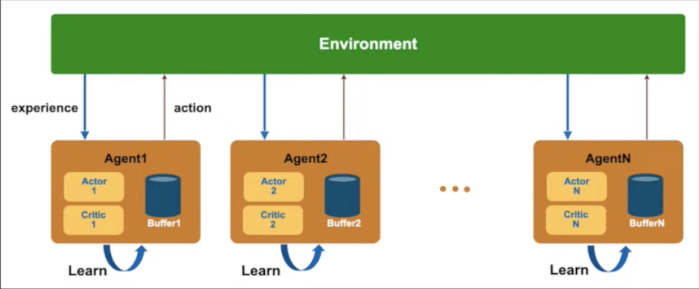
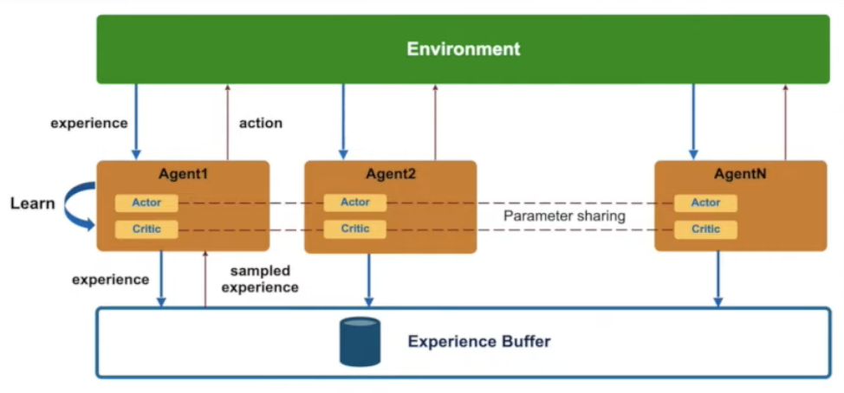
Basics: Resign a Multi-agent Reinforcement Learning model
Decentralized MARL & Centralized MARL
Notes:
So to move from a RL to MARL, there are two classic designs,

Slide 7
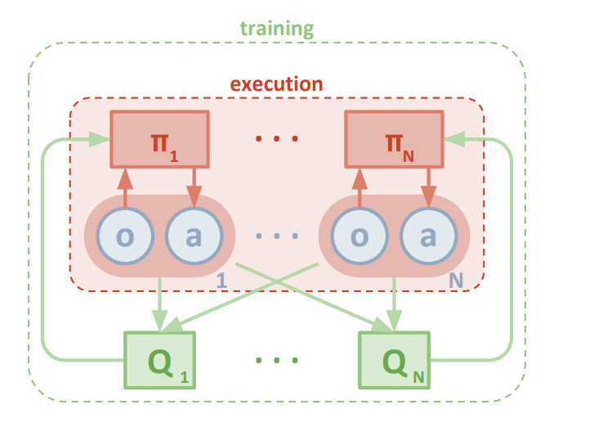
Background
Centralized Training &
Decentralized Execution
Notes:
Ok, now let’s move on to some main background stuff. By explaining the first term

Slide 8
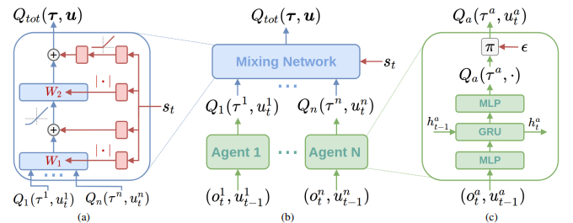
Background
Centralized Training &
Decentralized Execution
Value Function Factorization
Notes:
The second term is Value Function Factorization. So another issue from single agent RL to MARL is that most of the cases there would be only one reward from the environment and this could be a problem.
Since in single agent, the reward directly tells the agent how good or bad that action from the decision-making is. But in MARL, all agents shares a same reward based on their joint action selection. For example, in a soccer game, one player made the goal but all team members will share a same score. How do we tell a player if that kicking the ball led to the score or just sitting around?

Slide 9
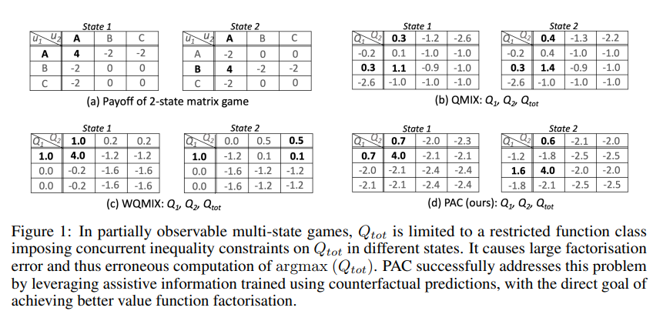
Limitations: A Partially Observable Multi-state Matrix Problem
0.5
0.5
0.5
s1
s2
0.5
Notes:
5:30

Slide 10
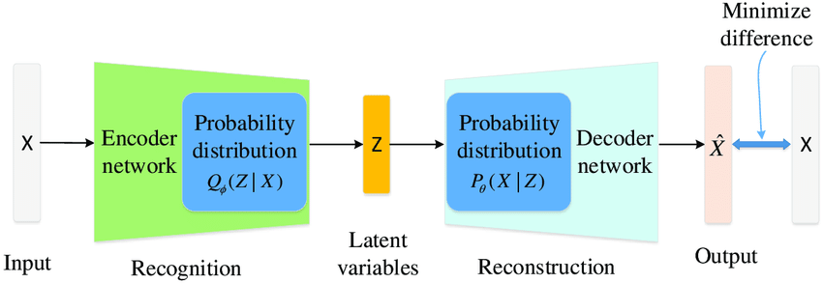

Information is needed!
But how?
A VAE modeling Information bottleneck problem.
Notes:
6:30

Slide 11

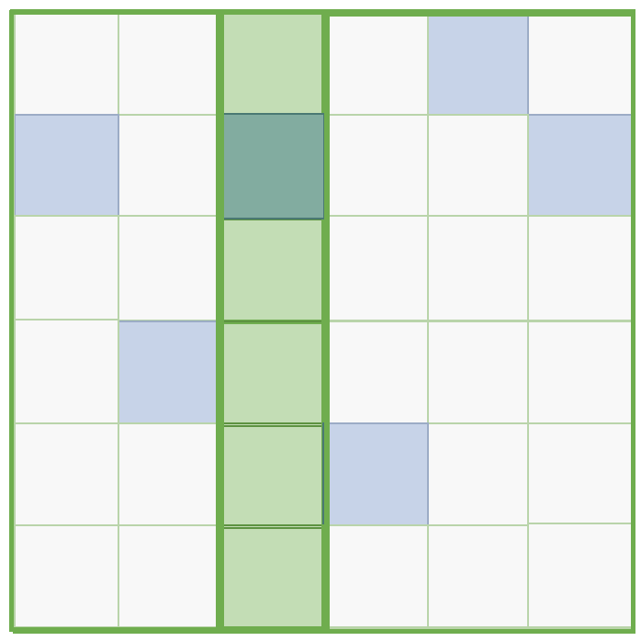












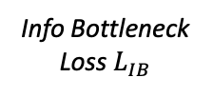








General Framework
$$Q_{tot }(τ_{t},u_{t})$$
$Q_{tot }$
Info Bottleneck
Loss $L_{IB}$
Mixing Network
$$s_{t}$$
$$q_{t}^{1}(u_{t}^{1},τ_{t}^{1},m_{t}^{−1})$$
…
$$q_{t}^{i}(u_{t}^{i},τ_{t}^{i},m_{t}^{−i})$$
…
$$q_{t}^{n}(u_{t}^{n},τ_{t}^{n},m_{t}^{−n})$$
$${\hat{u}}_{t}=({\hat{u}}_{t}^{1},…,{\hat{u}}_{t}^{n})$$
$$m_{t}^{i}$$
Agent 1
Agent $i$
Agent n
$${\hat{u}}_{t}^{i}$$
VAE
$$u_{t}^{i}$$
$${\hat{Q^{ }}}^{∗}$$
$$q_{t}^{i}(⋅,τ_{t}^{i},m_{t}^{−i})$$
$$o_{t}^{i}$$
Local Policy
Local Critic
$${ π}_{i}\left(\text{﹒} | τ_{t}^{i}\right)$$
$${\hat{u}}_{t}^{∗}=({\hat{u}}_{t}^{∗1},…,{\hat{u}}_{t}^{∗n})$$
$$o_{t}^{i}$$
$$m_{t}^{−i}$$
$${\hat{u}}_{i}^{∗}=\operatorname{argmax}{\hat{Q^{∗}}\left(\text{﹒},s_{t},τ_{t},{\hat{u}}_{t}^{−i}\right)}$$
Local Policy Loss $L_{LP}$
Counterfactual Prediction Loss $L_{LF}$
Notes:
7:00

Slide 12
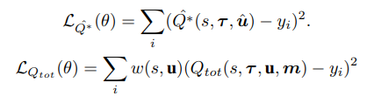
General Framework : Q_tot
$$Q_{tot }(τ_{t},u_{t})$$
$Q_{tot }$
Mixing Network
$$s_{t}$$
$$q_{t}^{1}(u_{t}^{1},τ_{t}^{1},m_{t}^{−1})$$
…
$$q_{t}^{i}(u_{t}^{i},τ_{t}^{i},m_{t}^{−i})$$
…
$$q_{t}^{n}(u_{t}^{n},τ_{t}^{n},m_{t}^{−n})$$
Agent 1
Agent $i$
Agent n
$${\hat{u}}_{t}^{i}$$
$$u_{t}^{i}$$
$$q_{t}^{i}(⋅,τ_{t}^{i},m_{t}^{−i})$$
Local Policy
Local Critic
$${ π}_{i}\left(\text{﹒} | τ_{t}^{i}\right)$$
$$o_{t}^{i}$$
$$m_{t}^{−i}$$
a weighted Qtot utilizing per-agent local critics qi(ui , τi , mi), where mi serves as assistive information aiding value factorization,

Slide 13

General Framework: Q^*
$${\hat{u}}_{t}=({\hat{u}}_{t}^{1},…,{\hat{u}}_{t}^{n})$$
$${\hat{Q^{ }}}^{∗}$$
$${\hat{u}}_{t}^{∗}=({\hat{u}}_{t}^{∗1},…,{\hat{u}}_{t}^{∗n})$$
$${\hat{u}}_{i}^{∗}=\operatorname{argmax}{\hat{Q^{∗}}\left(\text{﹒},s_{t},τ_{t},{\hat{u}}_{t}^{−i}\right)}$$
an unrestricted joint action estimator Qˆ∗ , which serves as a baseline estimator of Q∗ and allows the computation of counterfactual predictions from a quick local search

Slide 14
General Framework : VAE
$$m_{t}^{i}$$
VAE
$$o_{t}^{i}$$
$${\hat{u}}_{t}^{∗}=({\hat{u}}_{t}^{∗1},…,{\hat{u}}_{t}^{∗n})$$
$${\hat{u}}_{i}^{∗}=\operatorname{argmax}{\hat{Q^{∗}}\left(\text{﹒},s_{t},τ_{t},{\hat{u}}_{t}^{−i}\right)}$$
an assisted information generating module, which is able to utilize the deep variational bottleneck method to encode the counterfactual optimal joint action selection

Slide 15


General Framework: Policy Network
$$u_{t}^{i}$$
Local Policy
$$o_{t}^{i}$$
a policy network from the soft-actor-critic framework that’s responsible for decision making

Slide 16
Training Procedure
counterfactual assistance loss
Assistive Info generation loss
factorized soft policy loss, with temperature updating
Factorization Network Loss

Slide 17

General Framework
$$Q_{tot }(τ_{t},u_{t})$$
$Q_{tot }$
Info Bottleneck
Loss $L_{IB}$
Mixing Network
$$s_{t}$$
$$q_{t}^{1}(u_{t}^{1},τ_{t}^{1},m_{t}^{−1})$$
…
$$q_{t}^{i}(u_{t}^{i},τ_{t}^{i},m_{t}^{−i})$$
…
$$q_{t}^{n}(u_{t}^{n},τ_{t}^{n},m_{t}^{−n})$$
$${\hat{u}}_{t}=({\hat{u}}_{t}^{1},…,{\hat{u}}_{t}^{n})$$
$$m_{t}^{i}$$
Agent 1
Agent $i$
Agent n
$${\hat{u}}_{t}^{i}$$
VAE
$$u_{t}^{i}$$
$${\hat{Q^{ }}}^{∗}$$
$$q_{t}^{i}(⋅,τ_{t}^{i},m_{t}^{−i})$$
$$o_{t}^{i}$$
Local Policy
Local Critic
$${ π}_{i}\left(\text{﹒} | τ_{t}^{i}\right)$$
$${\hat{u}}_{t}^{∗}=({\hat{u}}_{t}^{∗1},…,{\hat{u}}_{t}^{∗n})$$
$$o_{t}^{i}$$
$$m_{t}^{−i}$$
$${\hat{u}}_{i}^{∗}=\operatorname{argmax}{\hat{Q^{∗}}\left(\text{﹒},s_{t},τ_{t},{\hat{u}}_{t}^{−i}\right)}$$
Local Policy Loss $L_{LP}$
Counterfactual Prediction Loss $L_{LF}$

Slide 18
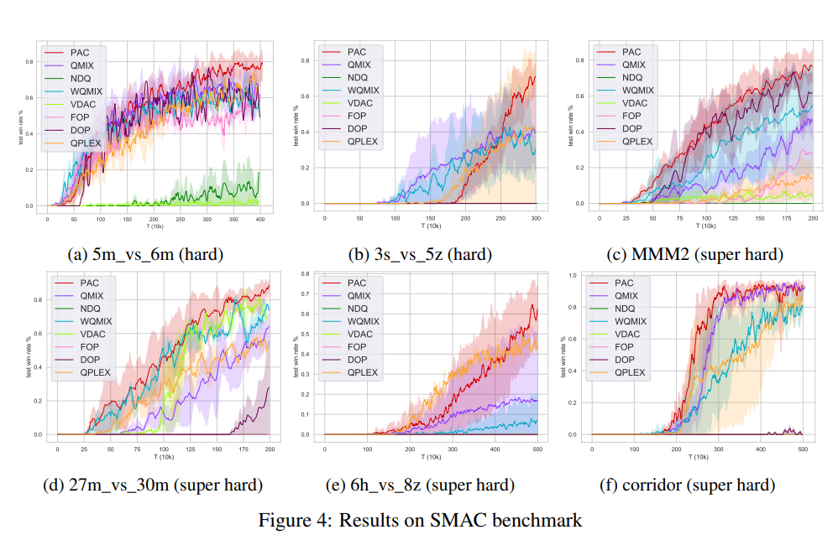
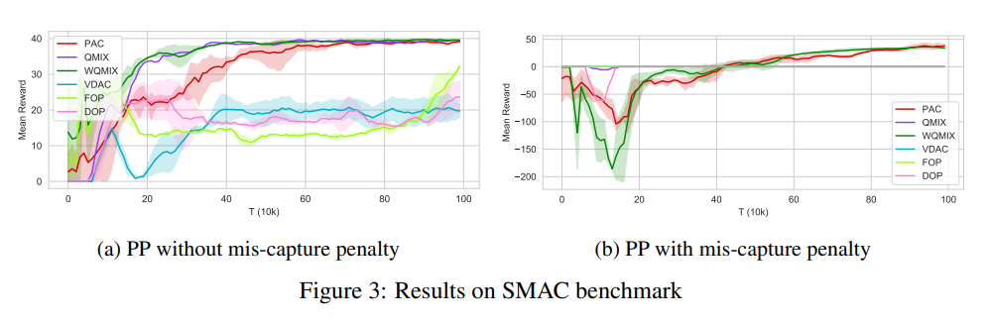
Result
VideoDemos
Notes:
8:30

Slide 19
Summary
*Basics to the Background
Background
Limitations
Our Design
Experiment
HANHAN@GWU.EDU
Notes:
9:30

Slide 20

PAC: Assisted Value Factorization with Counterfactual Predictions in Multi-Agent Reinforcement Learning
Hanhan Zhou$^{1}$, Tian Lan$^{1}$, Vaneet Aggarwal$^{2}$
$^{1}$ The George Washington University
$^{2}$ Purdue University

